Slide 1
Funding Transportation
2025 Nevada Transportation Conference
Scott Hein
May 13, 2025

Slide 2
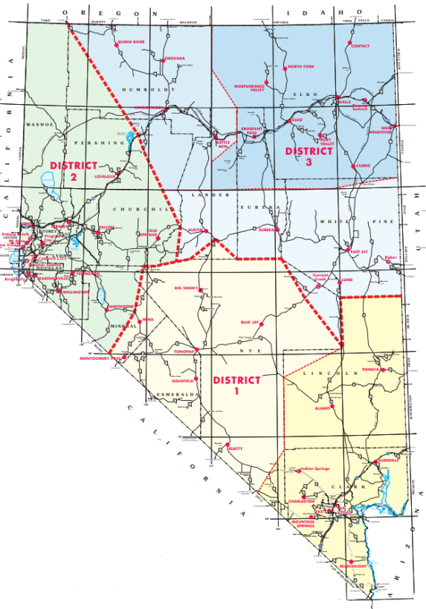
Nevada DOT Overview
NUMBER OF FTES
1,615 plus temporary/seasonal
MAJOR DIVISIONS
  Administration & Planning
  Project Delivery & Engineering
  Operations & Maintenance
NUMBER OF MAINTENANCE DISTRICTS: 3
  With 3 major subdistricts
STATE HIGHWAY SYSTEM
  Bridges: 1,239
  Lane Miles: 13,595
Notes:
NDOT is responsible for the planning, construction, operation and maintenance of 13,000+ lane miles of highway and over 1,000 bridges that make up Nevada’s highway system.
We maintain the highways that get food and other supplies to Nevada families.
Our highway system supports more than half of all vehicles traffic and 72% of all heavy truck traffic.
14% of all Nevada Roads
51% of all vehicular traffic
72% of all heavy truck traffic
Vision Statement:
To be a leader and partner in delivering effective transportation solutions for a safe and connected Nevada
Mission Statement:
Provide, operate, and preserve a transportation system that enhances safety, quality of life, and economic development through innovation, environmental stewardship, and a dedicated workforce
Goals:
Safety First
Cultivate Environmental Stewardship
Efficiently Operate & Maintain the State Transportation System
Enhance Internal & External Communications
Enhance Organizational and Workforce Development
Consistent and Effective Data Management

Slide 3
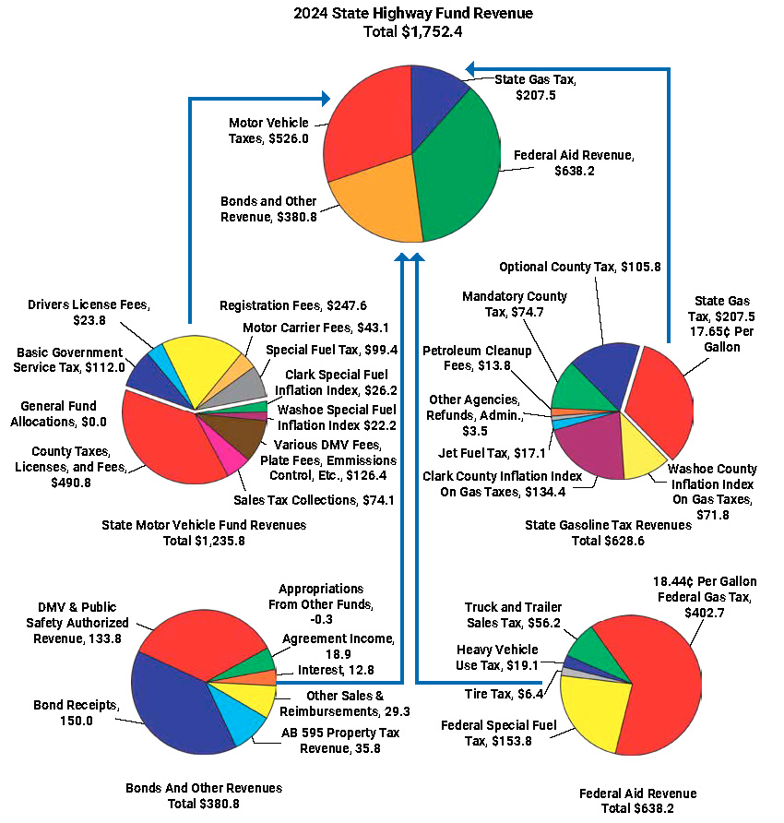
FY2024 Nevada Highway
Fund Revenue Sources)
$1.752 B State Highway Fund Revenue
MOTOR VEHICLE FEES & TAXES - $526.0 M
  $247.6M - Registration Fees
  $43.1M - Motor Carrier Fees
  $23.8M - Driver's License Fees
  $211.5M – Other Misc. Revenue
FEDERAL REVENUE - $638.2 M
  $402.7M – 18.44 cent federal gas tax
  $153.8M – Federal Special Fuel Tax
  $81.7M - Other Misc. Revenue
Notes:
State highways maintained by NDOT are funded primarily with highway-user revenue and federal funds. ​
Nevada’s Highway Fund receives revenue from different sources:
Fuel taxes make up a substantial part of Highway Fund user revenue. The federal fuel tax rate of 18.4 cents per gallon and the state rate of 17.65 cents per gallon has not changed since the early 1990s.
Registration, commercial carrier, driver’s license fees, and a portion of Government Services Taxes also contribute to the state Highway Fund.
Local fuel tax indexing, though, has been implemented in Clark and Washoe counties, and some Clark County fuel tax indexing became available for the state projects starting in fiscal year 2018.
2023 HIGHWAY FUND REVENUE
TOTAL State Highway Fund Revenue: $ 1.3 billion
State Gas Tax and Motor Vehicle Taxes: $659 million
Federal Aid Highways: $ 638.2 million
Department also funds projects via sale of HIGHWAY REVENUE Bonds to support large highway construction projects
Radio System upgrade to P25 ($22.9M) appropriations

Slide 4
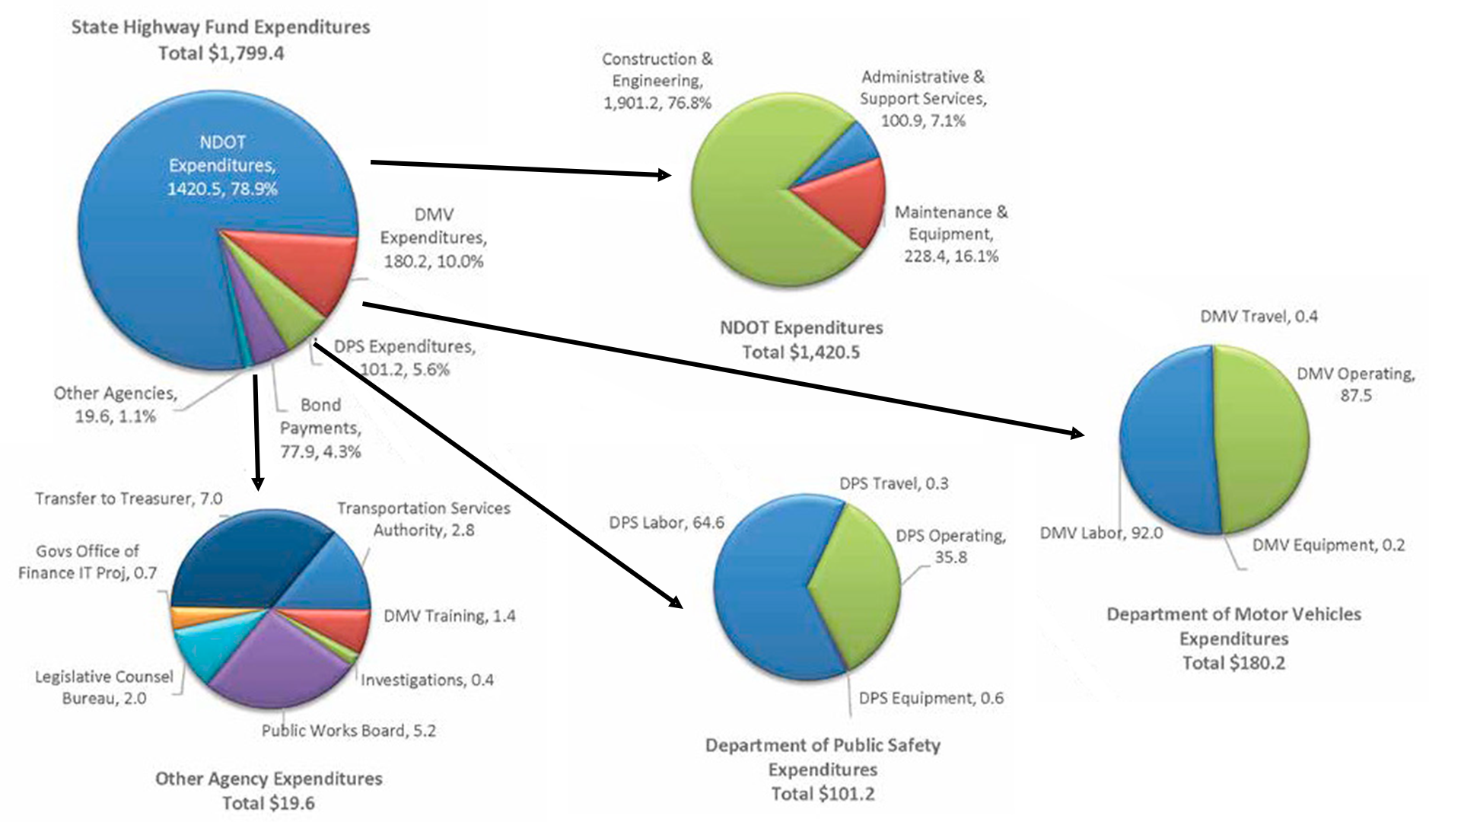
State Highway Fund Expenditures – FY 2024
Notes:
NDOT: $ 1,049,000.00 - 74.7%
DMV: $ 1,580,000.00 - 11.2%
DPS: $ 82,400,000.00 - 5.9%
Other: $ 44,500,000.00 - 3.2%
TOTAL: $ 1,404,900,000.00

Slide 5
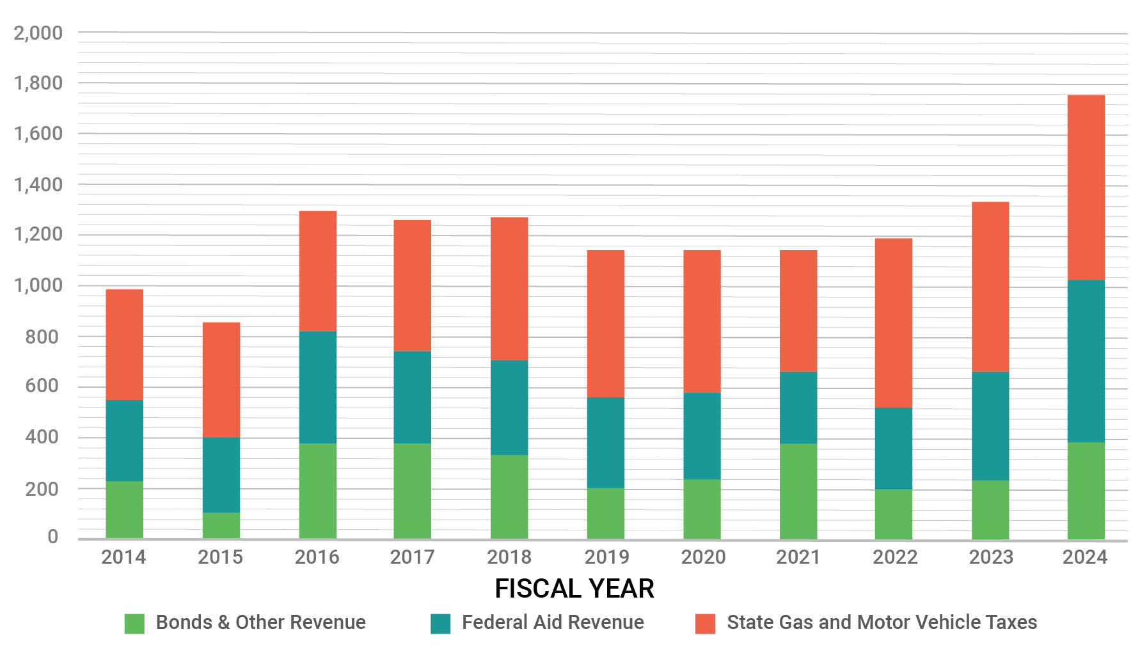
State Highway Fund Revenue
Mix of motor vehicle taxes and fees, fuel taxes, and federal funds.
2024 Revenue = $1.334B

Slide 6

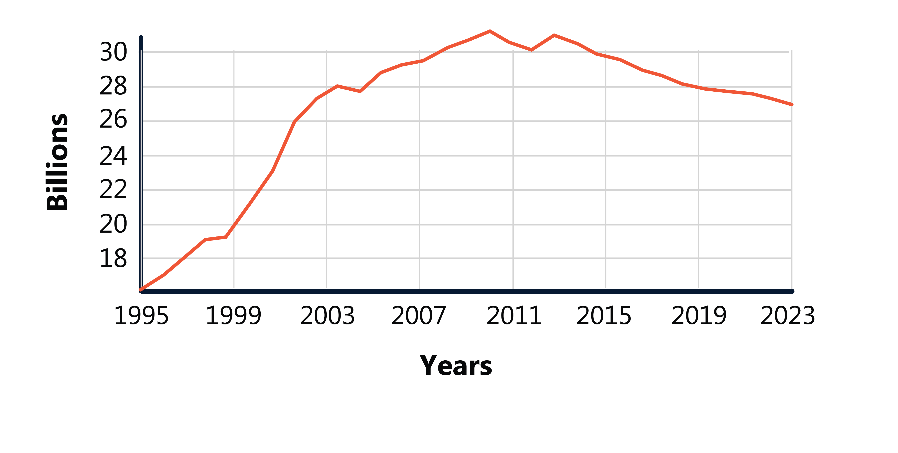
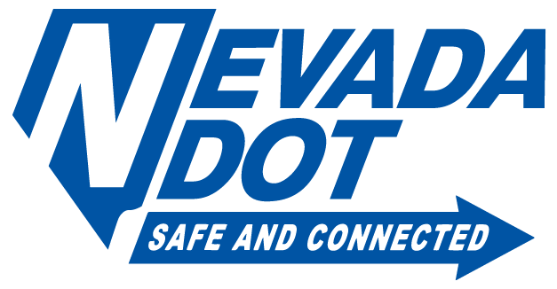
Federal Tax Revenue Trends
Federal gas tax revenue is also under pressure due to declining fuel consumption. Federal shortfalls are primary funded from general tax transfers.
Federal Gas Tax Revenue Trends (1993-2023)
Notes:
As you can see, Federal Gas Tax revenue has been declining over the last 10 years.
When there are shortfalls in the Federal Highway Trust Fund (which is common now), the federal government transfers general tax revenue – often derived from bond sales - to support the HTF.
As shown earlier, VMT continues to increase federally, though not anywhere near the pace as in Nevada. So, why is revenue declining. Simple: average fuel economy has increased significantly. This is not a result of just Evs, but just about any vehicle purchased today has a significantly higher fuel economy than the same model from 10 or more years ago.
So, as you hear about increasing federal funding for transportation and other infrastructure, it’s important to note that this revenue vs expenditure imbalance has not been solved at the national level. Or in simpler terms, the once solvent and efficient Highway Trust Fund is no longer keeping pace with the transportation funding being authorized and expended.

Slide 7
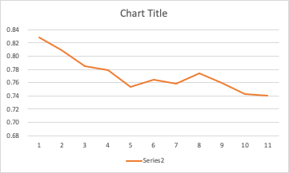
Nevada’s Gas Tax Revenue
The erosion in fuel tax revenue will accelerate as more vehicles use less gasoline (or no gas at all).
Nevada State Gas Tax Revenue Per Mile
(3-year rolling average)
2012
2013
2014
2015
2016
2017
2018
2019
2020
2021
2022
2023
Notes:
Here’s our situation with our Nevada gas tax:
over the last 10 years or so, our gas tax revenue per mile driven has been declining. For example, in 2012 we collected about 0.83 cents per mile driven on our roadways.
But with increasing fuel economy, including electric vehicles, today we are only collecting about 0.74 cents per mile driven.
This downward trend is expected to accelerate – that is, get worse – over the next 15 to 20 years,

Slide 8
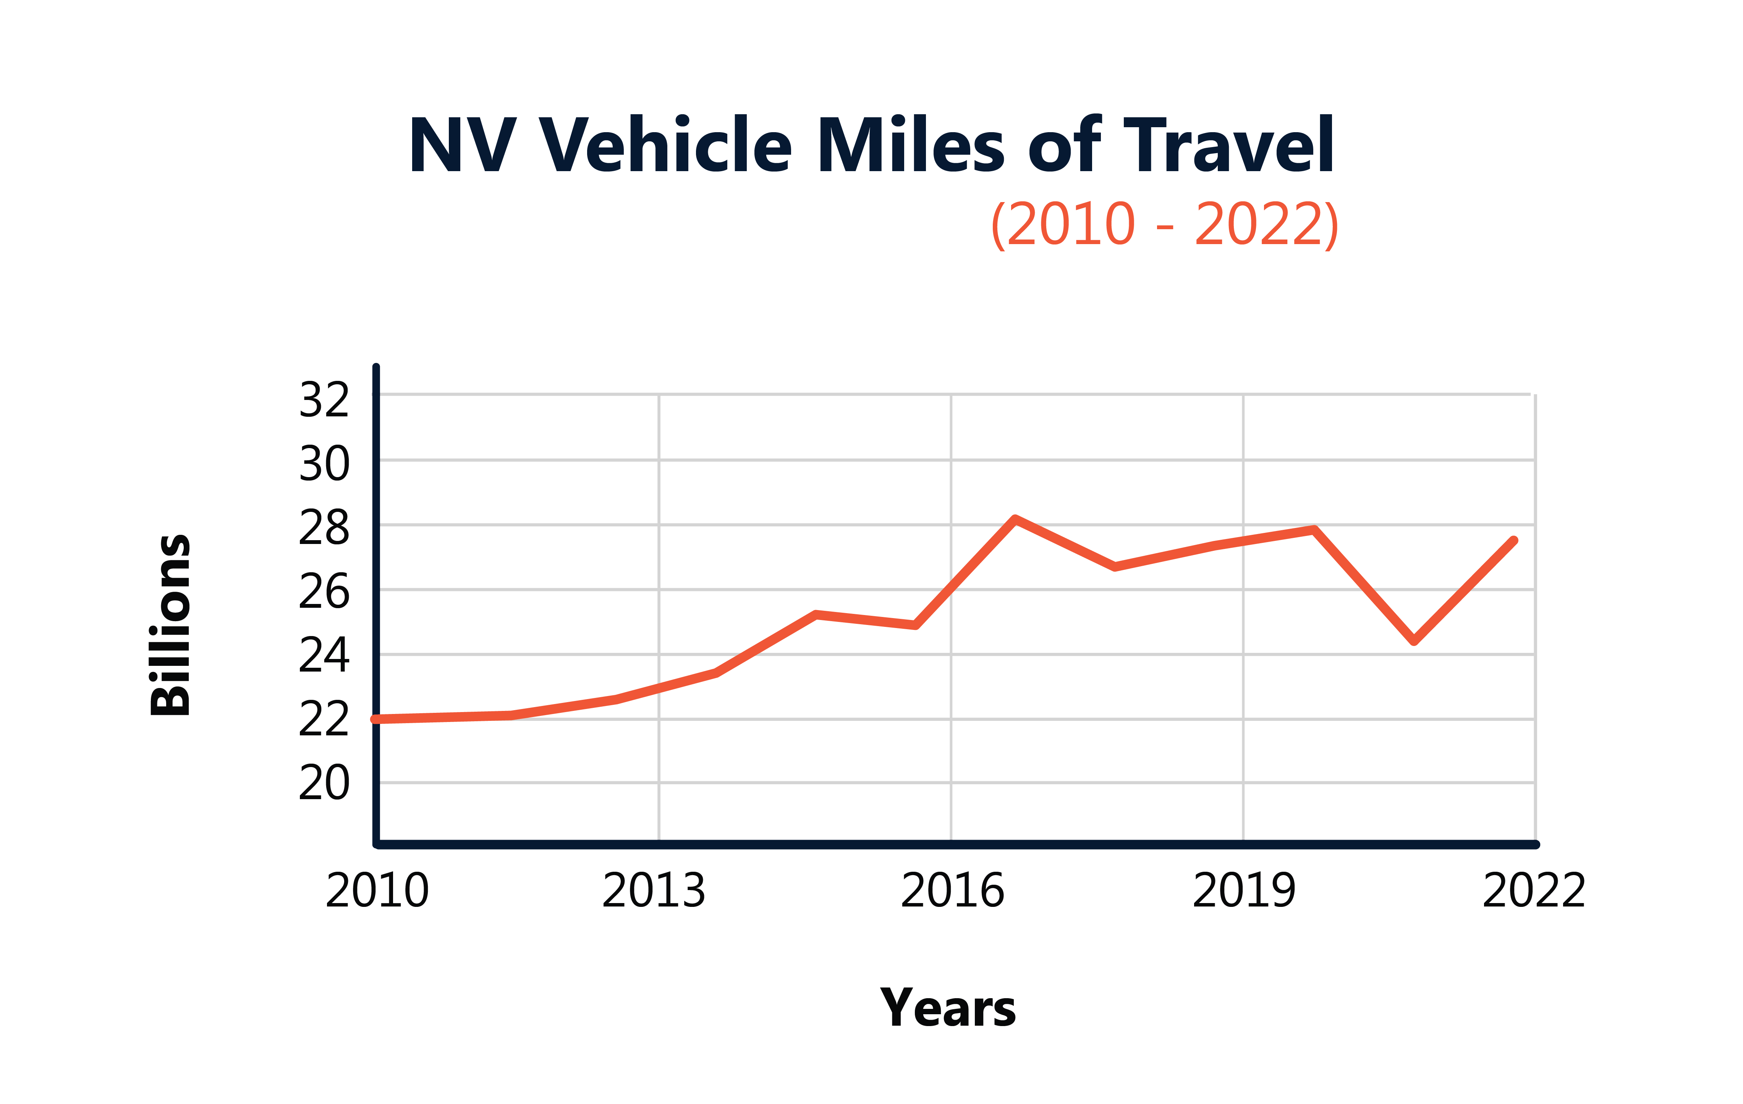

Vehicle Miles Traveled (VMT) in Nevada
Increases in Vehicle Miles Traveled (VMT) on Nevada roadways has been four times greater than the U.S. average.​
Vehicle Miles Traveled (VMT
Source: US Census Bureau
25%
Nevada VMT
Increase, 2010 - 2023
6%
US VMT
Increase, 2010 - 2023
Notes:
Not only is the population rapidly increasing, but the vehicle miles travelled is outpacing population growth and more than four times the national average.
So not only do we have more people moving to Nevada and using the roadways, but the distances traveled by everyone is increasing.

Slide 9
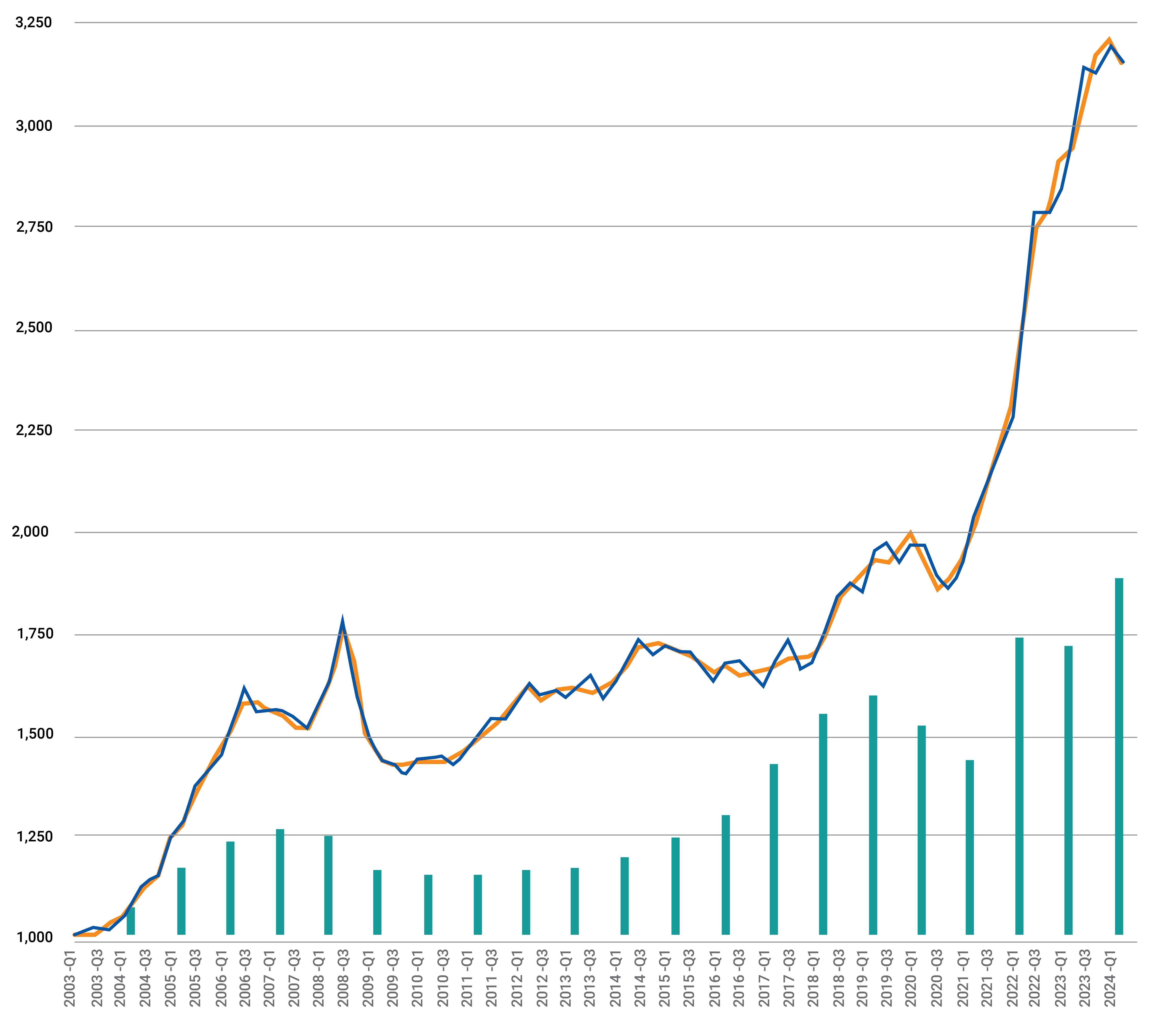

Inflation Outpaces
Revenue Growth
National Highway Construction
Cost Index ( NHCCI)
vs Highway Fund State User Revenue Growth
Escalating Costs
Like other states, NDOT has seen highway​ construction costs skyrocket.
Asphalt, Concrete, Steel, Labor
Supply Chain Issues
Highway construction costs rose by approx. ​68% from the Q4 of 2020 to the Q4 of 2023 ​
(FHWA Nat'l Highway Construction Cost Index)
Nationally 32% a year / NDOT average ~ 28%
Tariff's......who knows how that will impact the industry?
68%
COST INCREASE SINCE Q4 2020
Notes:
3.146 (blue)
3.055 (orange)

Slide 10





Gas Tax Alternatives
To help stabilize transportation funding, states are actively pursuing gas tax alternatives – often implementing two or more new revenue mechanisms
General revenue transfers
Registration surcharges on plug-in electric (EVs), hybrids, and alternative fuel vehicles
Taxes on electricity used to recharge EVs
Per-mile road usage charges (RUC)
Notes:
Nevada is not alone in having to address this problem – all of the states, plus the federal government, are now actively researching, testing, or implementing alternative funding options.
I’ll briefly highlight the four main options states have taken:
General Fund revenue transfers
Special registration fees for EVs and hybrids
Taxes on electricity used to charge EVs, and
Per-mile Road Usage Charges (RUC)

Slide 11
Electric Vehicle (EV) Registration Surcharges
As of July 2024, 38 states have enacted Electric Vehicle (EV) registration surcharges
Primary advantages:
All EV owners contribute to cost of roadways
Can be implemented through existing registration process
Primary disadvantages:
Does not reflect how much a driver uses roadways
Does not address biggest issue: increasing MPG among gas-powered vehicles
EV fee legislation introduced
EV fees enacted and collected
Fee Range: $50 - $240​
Lowest: Hawaii ($50)​
Highest:​ Washington ($225)​; Michigan ($240 for vehicles over 8k lbs.)​
Average: $130.45​
Median: $120 ​
Notes:
The most common response to declining gas tax revenue has been enactment of special registration fees (or “surcharges”) on electric vehicles.
Many states also extend those special fees to gas hybrid vehicles.
The fee amounts vary, as you can see on the far right of this slide, but the average fee in the U.S. is $130.
Nevada is one of the few states that has not considered a fee on EVs.
Based on our research, In Nevada, an EV fee that is comparable to what the average Nevada driver pays in gas taxes would be about $166 per year.

Slide 12

Staff Vacancies

Slide 13
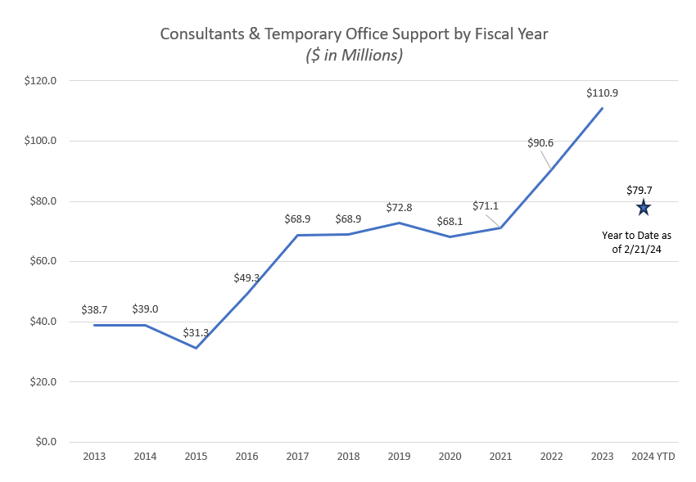
Vacancies Create Need for Outsourcing

Slide 14
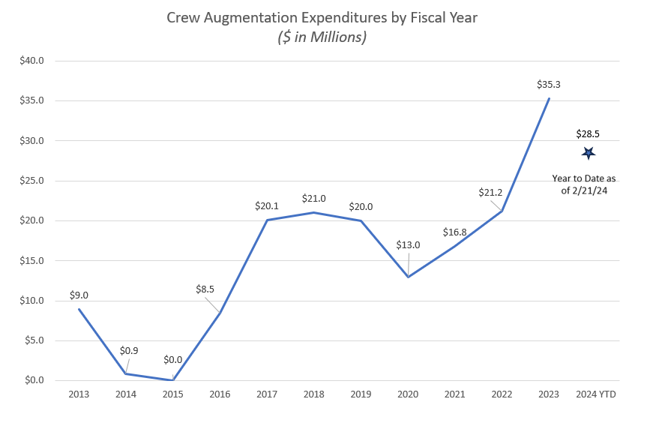
Construction Crew Augmentation

Slide 15







What is the One Nevada Process?
A data-driven, transparent process to identify and fund the best projects that achieve NDOT’s One Nevada Goals.
One NV Goal Areas
Long-Range Need Identification
Identify data-driven needs that are not being addressed and advance those needs into action
Needs Validation
Validate needs using data and shepherd valid needs forward to action
Mid-Range Program Level Prioritization
Evaluate project concepts using consistent NDOT process as well as division specific processes to recommend priority projects
Unconstrained Project List
Identify comprehensive list of projects to be considered for funding (coordinating the 5-year plan and STIP parking lots)
STIP & AWP Project Prioritization
Rank projects according to ability to meet One Nevada Goals and Cost Effectiveness
Harmonize the program of projects based on funding eligibility, project readiness, performance targets, and geographic distribution
STIP & AWP Harmonization
Notes:
SONDRA SLIDE
Reiterate it’s the continuation of a process that will evolve over the course of the next year
Ideally, the purpose is to have a project prioritization process at all stages of the performance based planning process
Started with the STIP – this is the beginning of the implementation of the ONTP
Without the Mid-Range process established, the current STIP Prioritization requires collecting a project list of both programmed projects as well as projects that are not programmed. This is a culture shift at NDOT.
The goal of the mid-range is to better establish a program outside of the STIP/ Work Program.

Slide 16

Thank You
Scott Hein, Assistant Director Engineering and Project Delivery
For more detailed information:
Sondra Rosenberg, Deputy Director
SRosenberg@dot.nv.gov ☺
Felicia Denney, Assistant Director Administration
Fdenney@dot.nv.gov ☺

